Slide 1
CUDA Performance Checklist
Mark Saroufim

Slide 2
Follow along
Locally or remotely https://lightning.ai/
git clone https://github.com/cuda-mode/lectures
cd lecture8
nvcc -o benchmark *.cu
ncu benchmark
Approach follows style of https://arxiv.org/pdf/1804.06826.pdf

Slide 3
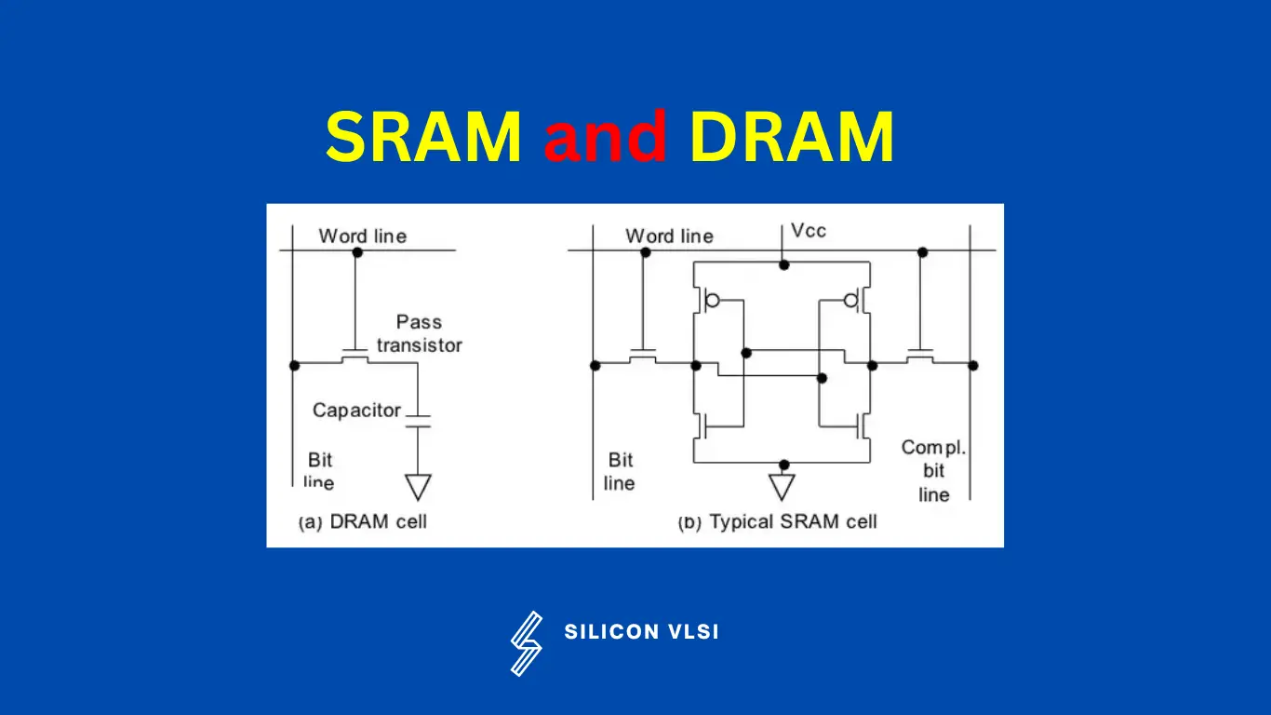
DRAM vs SRAM
DRAM: 1 transistor, 1 capacitor
SRAM: 6 transistors
So SRAM is faster but more expensive, takes up more space and gets hotter
Listen to Bill Dally talks on YouTube: https://www.youtube.com/watch?v=kLiwvnr4L80
https://siliconvlsi.com/why-sram-is-faster-than-dram/

Slide 4
Performance checklist
Coalesced Global Memory Access
Maximize occupancy
Understand if memory or compute bound
Minimize control divergence
Tiling of reused data
Privatization
Thread Coarsening
Rewrite your algorithm using better math

Slide 5
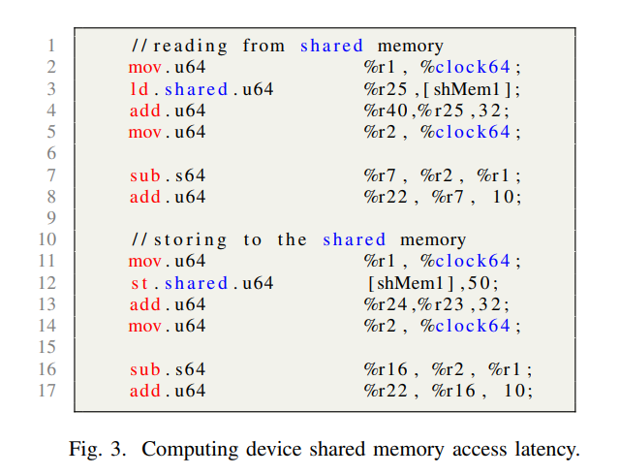
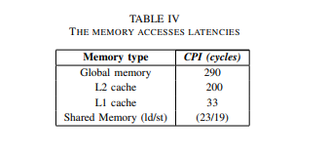
Memory latencies
https://arxiv.org/abs/2208.11174
Microbenchmarks using PTX

Slide 6
It’s the latency stupid
Throughput is easy, latency is not: “You can get 80 phone lines in parallel, and send one single bit over each phone line, but that 100ms latency is still there.”
Quantization: “For example, to reduce packet size, wherever possible Bolo uses bytes instead of 16-bit or 32-bit words.”
http://www.stuartcheshire.org/rants/latency.html

Slide 7
Memory Coalescing
You can’t reduce latency but you can hide it by reading contiguous elements of memory
Case study - pay attention to
DRAM Throughput
Duration
L1 cache throughput

Slide 8
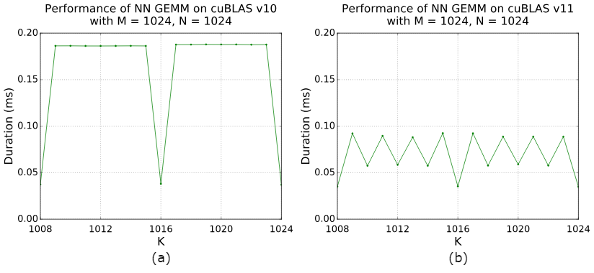
Occupancy
Tile quantization: matrix dimensions are not divisible by the thread block tile size.
Wave quantization: total number of tiles is not divisible by number of SM on GPU
https://docs.nvidia.com/deeplearning/performance/dl-performance-matrix-multiplication/index.html

Slide 9
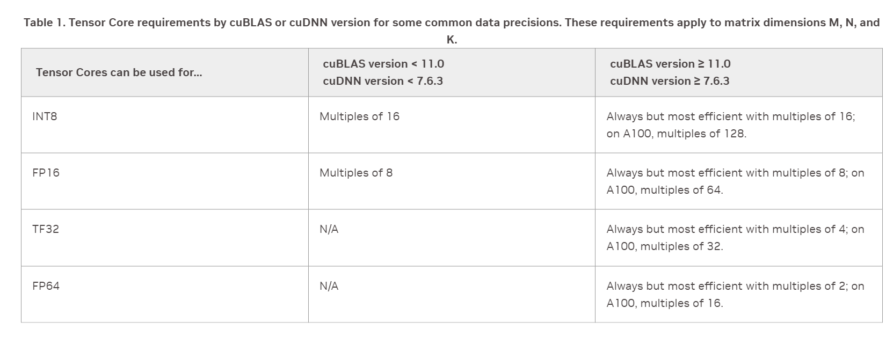
Solution in PyTorch Land: Padding
https://docs.nvidia.com/deeplearning/performance/dl-performance-matrix-multiplication/index.html

Slide 10
Solution in CUDA Land: Change the kernel
Back to our case study let’s change the kernel launch params

Slide 11
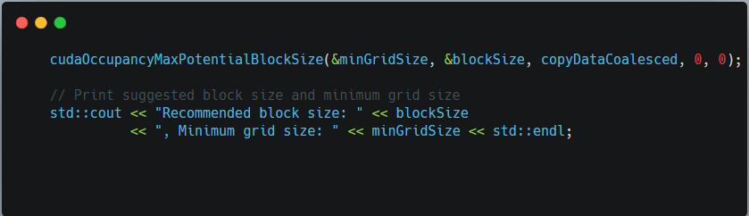
CUDA Occupancy calculator
This used to be an excel spreadsheet!
Turns out optimal for T4 is grid: 40 and blocks 1024

Slide 12
Still has 1 more problem
WRN Memory is more heavily utilized than Compute: Look at the Memory Workload Analysis section to identify the
DRAM bottleneck. Check memory replay (coalescing) metrics to make sure you're efficiently utilizing the
bytes transferred. Also consider whether it is possible to do more work per memory access (kernel fusion) or
whether there are values you can (re)compute.

Slide 13
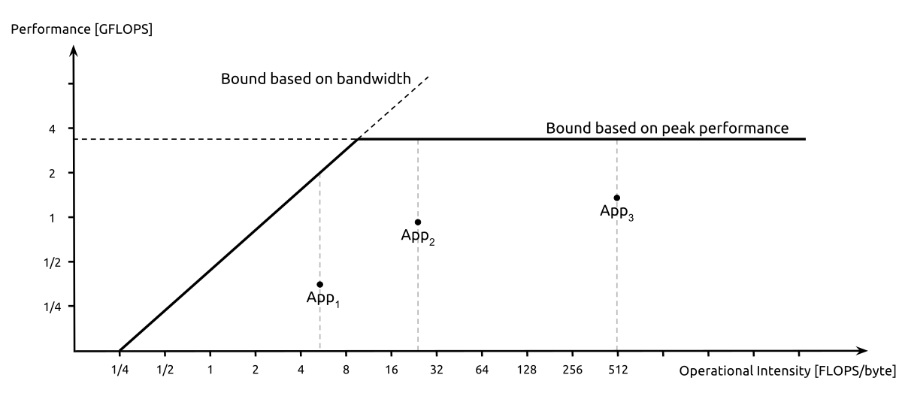
Roofline model
https://en.wikipedia.org/wiki/Roofline_model

Slide 14
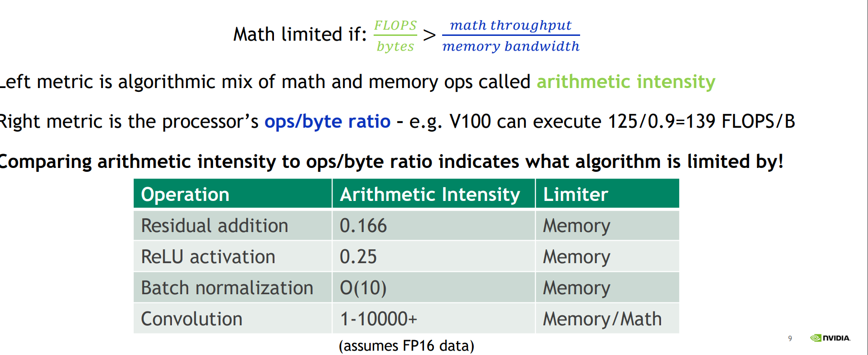
Arithmetic intensity
https://developer.download.nvidia.com/video/gputechconf/gtc/2019/presentation/s9926-tensor-core-performance-the-ultimate-guide.pdf

Slide 15
Back of the envelope
Apply ReLU function elementwise on a vector: f(x) = max(0, x)
For each element 1 read, 1 comparison op and maybe 1 write
Assume float32 -> 4 bytes (32 / 8)
Ops: 1
Byte: 2 * 4 = 8
So arithmetic intensity in the worst case ⅛
Best case 1/4
1/4 < 1: Memory bound!

Slide 16
Let’s do this again with float16
Apply ReLU function elementwise on a vector: f(x) = max(0, x)
For each element 1 read, 1 comparison op and maybe 1 write
Assume float16 -> 2 bytes (16 / 8)
Ops: 1
Byte: 2 * 2 = 4
So arithmetic intensity in the worst case 1/4

Slide 17
Ok last one: Matmul
A = [M, N]
B = [N, K]
C = A * B
FLOPS: For each output in C need dot product between row of A and column of B -> N multiplications and N additions -> M * K * 2N
Bytes: MN + NK (load each matrix) and then write the output (MK): MN + NK + MK
AI = 2MNK / (MN + NK + MK)
Compute bound for large matrices otherwise bandwidth bound

Slide 18
TL;DR
Bandwidth Bound Kernels: Fuse, quantize, compile
Compute Bound Kernels: Write a better algorithm

Slide 19
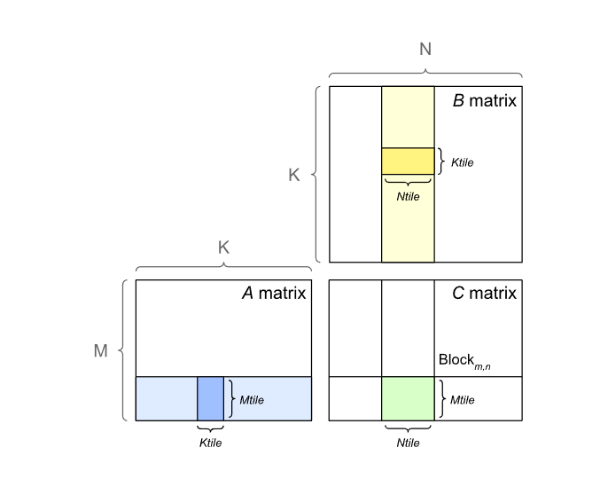
Tiling of reused data
Already covered in past CUDA MODE lectures https://www.youtube.com/@CUDAMODE
Less global memory traffic

Slide 20
Minimize control divergence
Related to occupancy but if conditions can be a source of a lot of threads not doing anything, this is bad!
Drastic difference
processArrayWithDivergence took 0.074272 milliseconds
processArrayWithoutDivergence took 0.024704 milliseconds
ncu --set full divergence
(Not sure why ncu shows avg divergence as 0)

Slide 21
Thread Coarsening
So far threads do as little as possible
But threads can do more and be faster
main ~/lecturex ./benchmark
VecAdd execution time: 0.245600 ms
VecAddCoarsened execution time: 0.015264 ms
Half as many threads launched
Why is this faster? Hint: AI

Slide 22
Privatization
Apply partial updates to private copy of data before writing back to global or shared memory.
Example: Sliding window algorithm
1 2 [3] [4] [5] 6 7
Higher occupancy
Higher compute SM throughput
Lower DRAM throughput

Slide 23
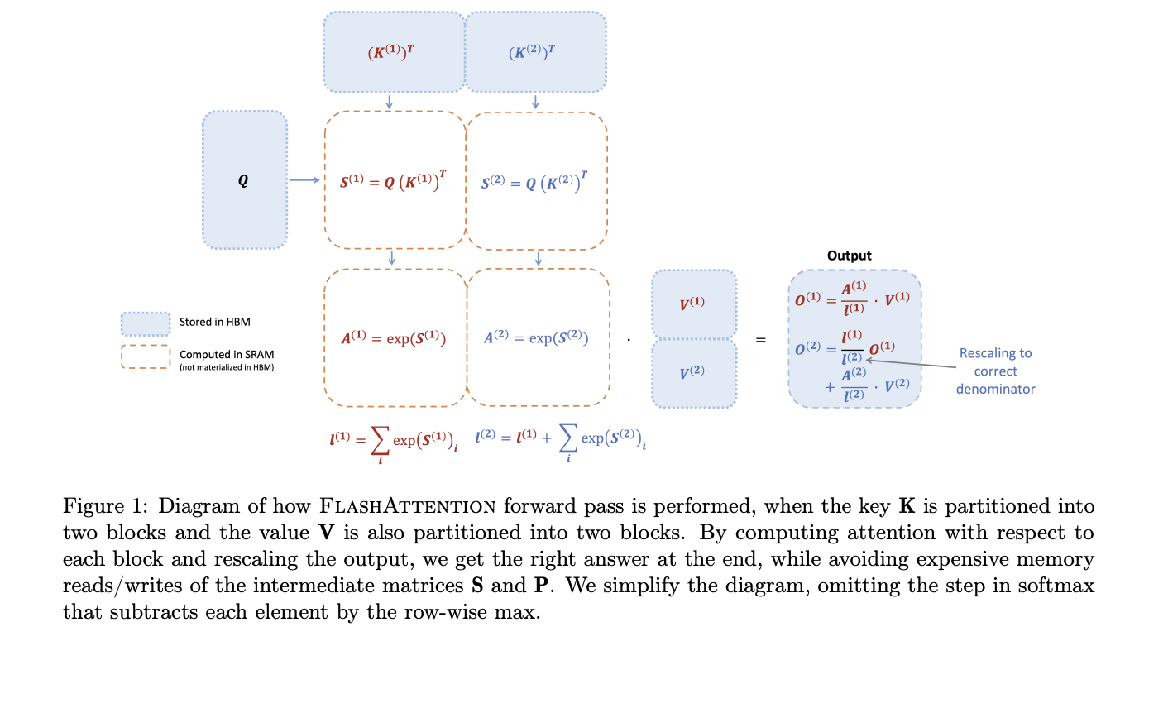
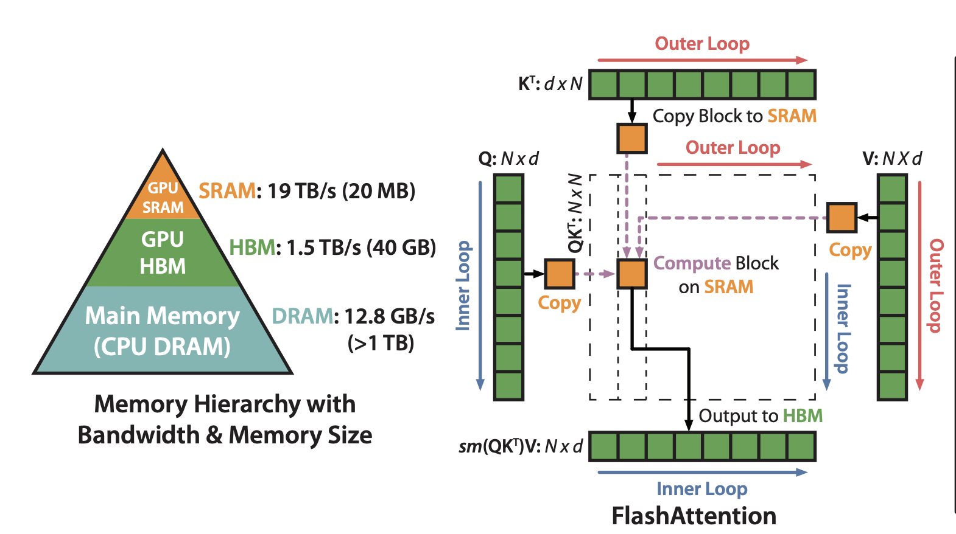
softmax(QK^T) V
https://arxiv.org/abs/2205.14135
https://arxiv.org/abs/2307.08691

Slide 24
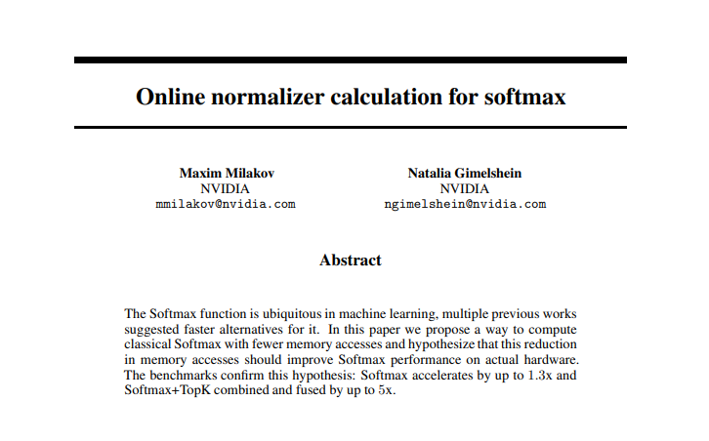
Be better at math
Flash Attention v1 has 2 tricks
softmax(QK^T) V
Tile based shared memory attention computation
Online softmax
https://arxiv.org/abs/1805.02867

Slide 25
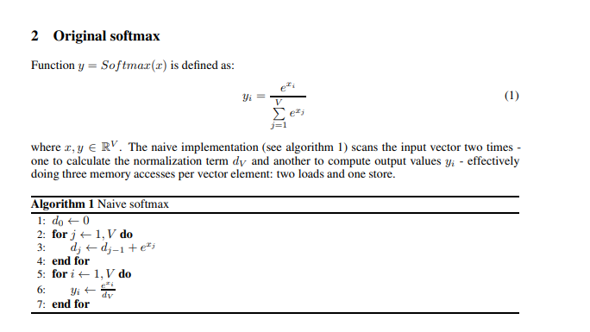
Softmax
3 memory accesses per element
2 reads
1 store
Also can overflow!
1 solution is to store result of exponent in float64 but not great

Slide 26
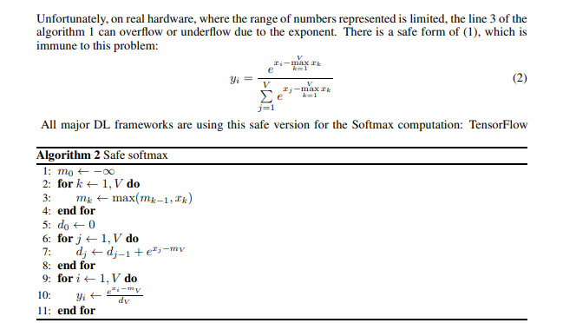
Safe softmax
4 memory access per element
3 read
1 store

Slide 27
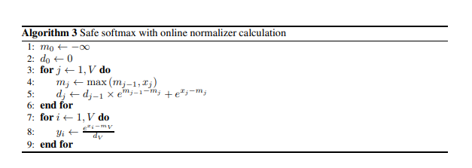
Online Softmax
Key insight is line 5 where we can do localwise corrections
e^{m-n} = e^m e^-n
Cancel out the fake max and use the true max
3 memory access per element
2 read
1 store

Slide 28
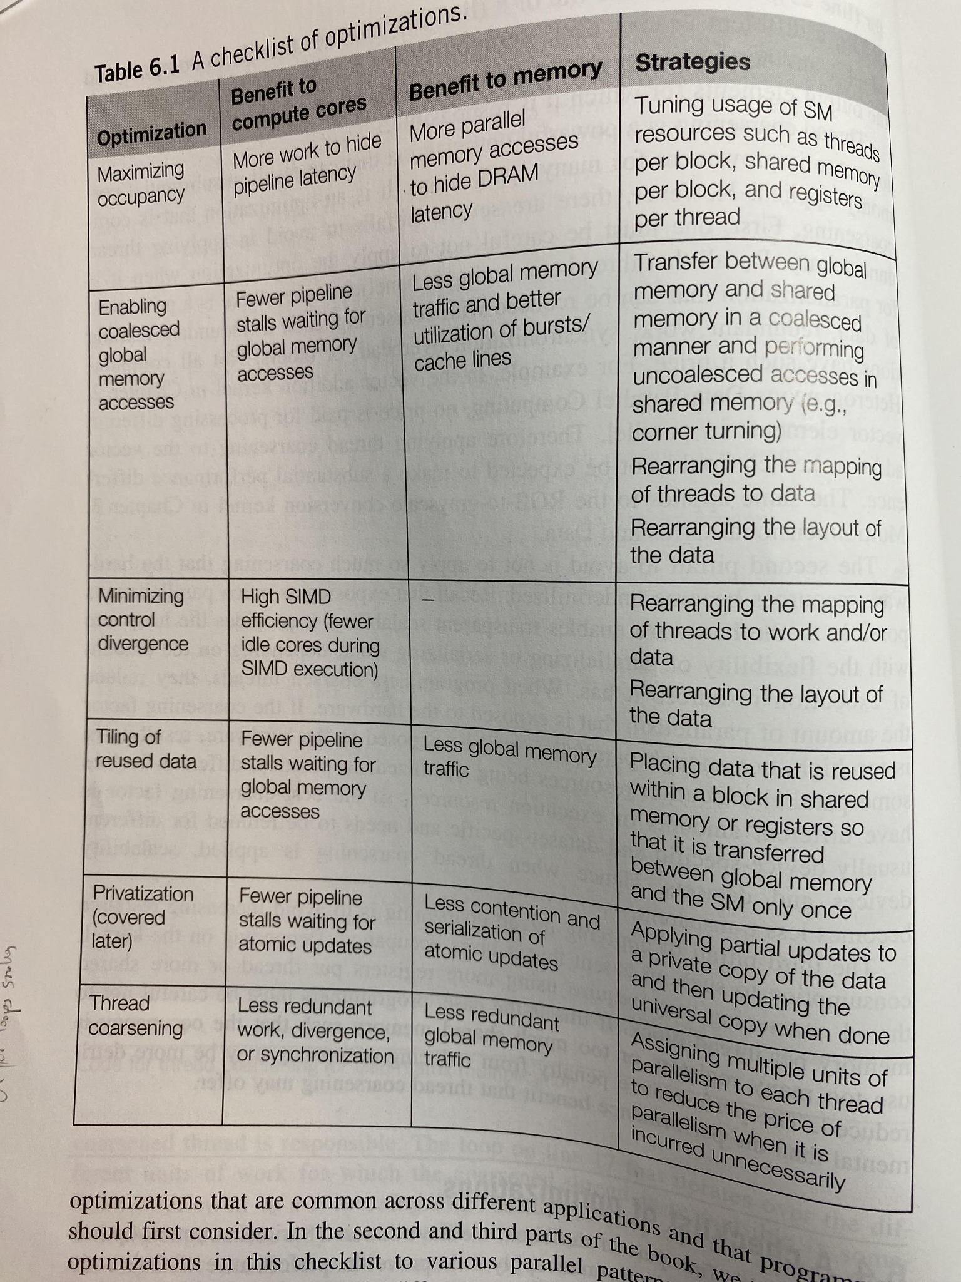
TL;DR
Table from the Book
+ Compute vs Memory Bound workflows
+ Better Math
CUDA MODE: Wield math and computers to reach brrr nirvana

